Slide 1
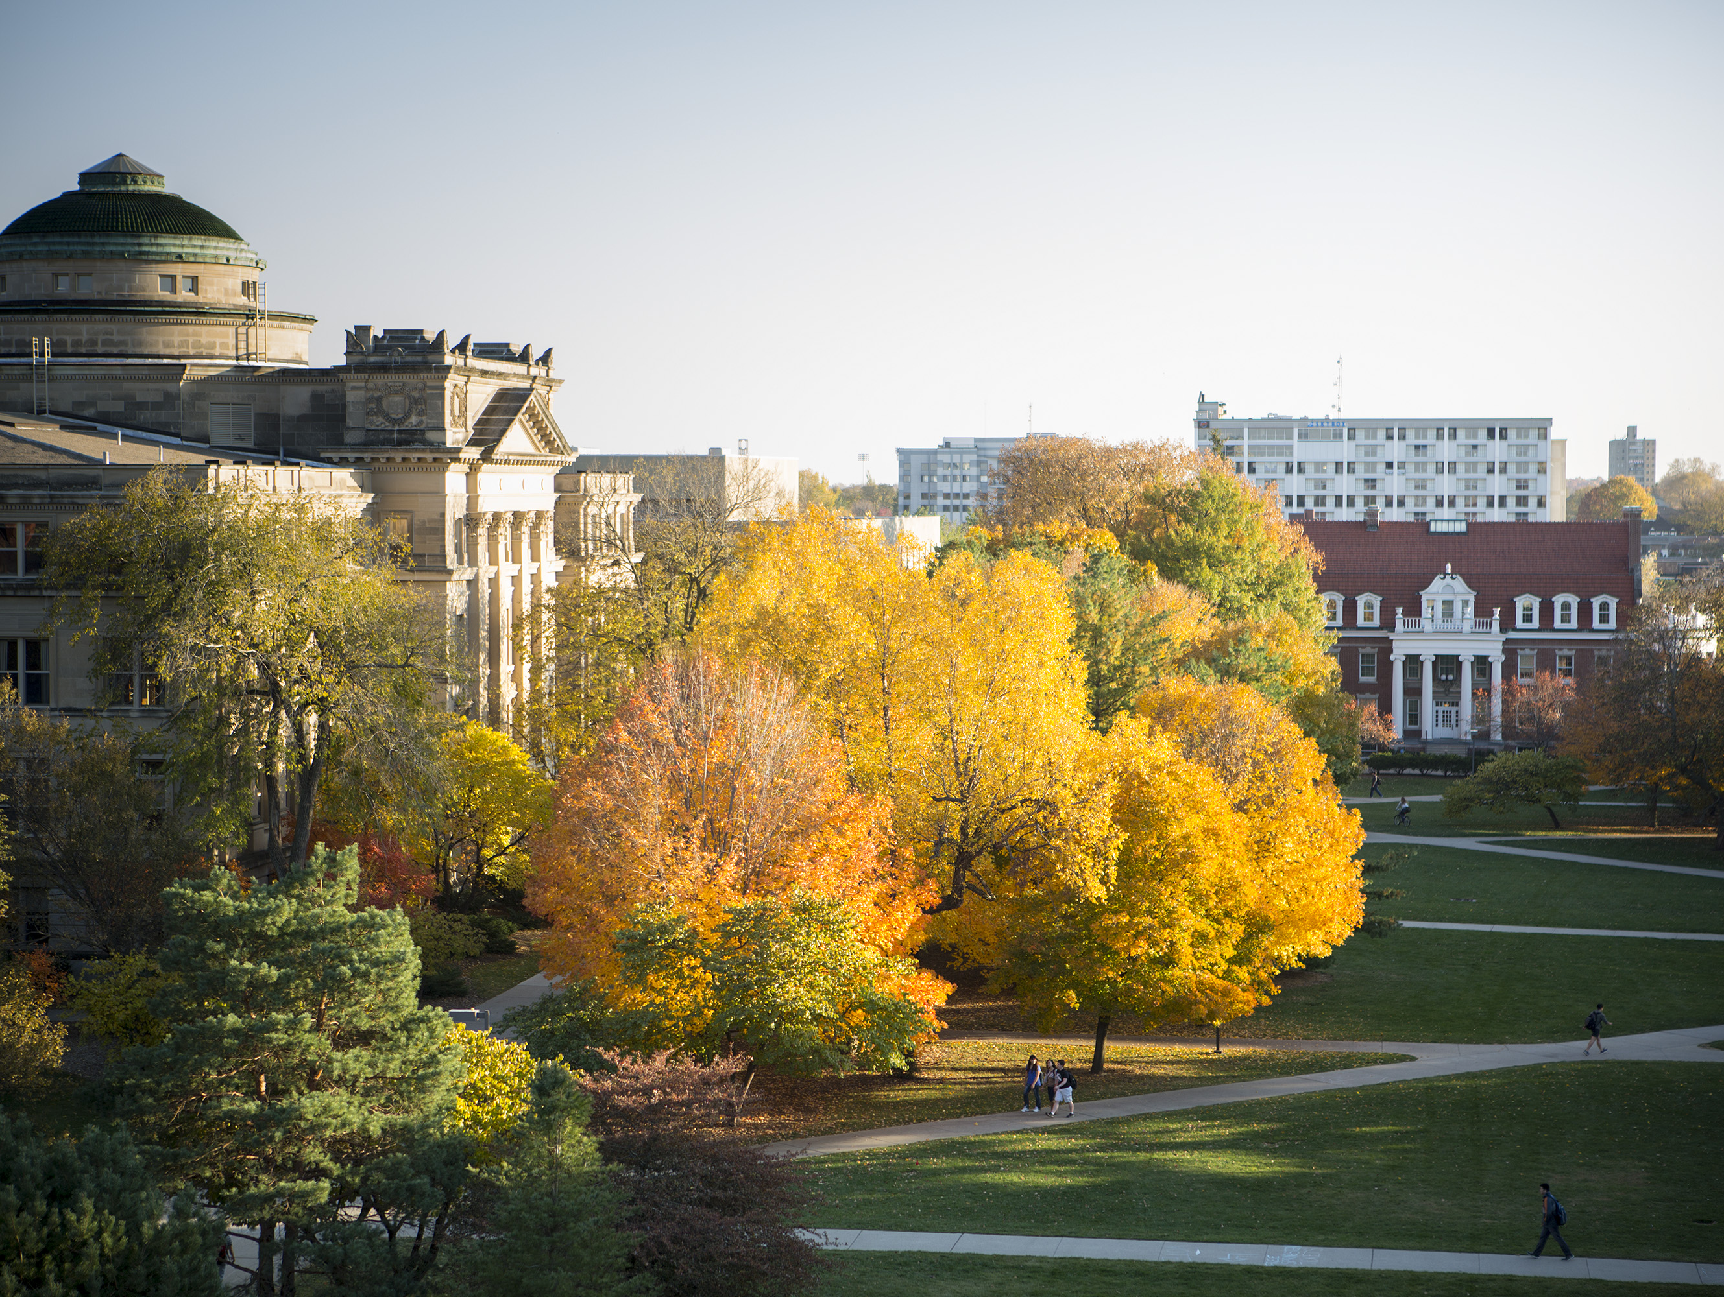
General Council Meeting | September 5, 2024 | Microsoft Teams
Welcome to our virtual meeting!
You may turn your camera on, but please remain muted until you are presenting or addressing Council.
To address Council or ask a question, please press the “Raise” button. You will recognize you when it is your turn to speak.
When recognized, you may unmute to speak. Mute again when done.
Please refrain from the use of emoji reactions unless expressly instructed.
Only councilors or their substitutes may vote.

Slide 2
Agenda
Call to Order – Jennifer Schroeder
Establish Quorum – Jennifer Schroeder & Sara Everson
Approval of Today’s Agenda – Jennifer Schroeder
Approval of Previous Meeting Minutes – Jennifer Schroeder
July 11, 2024

Slide 3
Administrative Reports
Amy Ward – Manager ITS

Slide 4
Identity Governance Project Update
Migration from Okta to Microsoft

Slide 5
Identity Governance Project Update
Monday, September 9
Monday, September 16
Campus-wide email
Set up your Multi-Factor Authentication and Self-Service Password Reset factors
Ability to add more factors
Public release of Microsoft Dashboard with Okta Parity
Migration of the Identity Provider from Okta to Microsoft
Migration of login.iastate.edu from Okta App Dashboard to Microsoft App Dashboard
Both Okta and Microsoft Application Dashboards will be available for a limited amount of time for user comparison

Slide 6
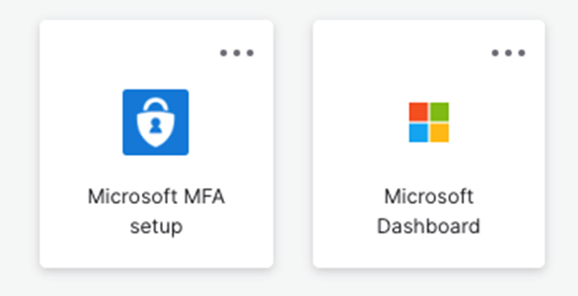
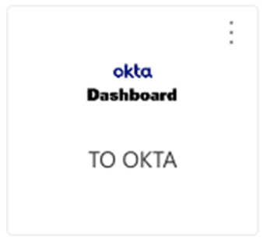
Application Dashboard Transition
Okta Dashboard
Microsoft Dashboard
Both Okta and Microsoft Application Dashboards will be available
for a limited amount of time for user comparison

Slide 7
MFA and Self-Service Password Reset Options:
Authenticator Apps
Microsoft and Google Phone
SMS, Call, Office Phone
Secondary Email Address
Secondary Email Address
Self-service password reset only

Slide 8
Coming Soon
Role account migration
Future communications regarding those changes.
Yubikey option and instructions
Current users watch for instructions
Reuse your existing Yubikey
Migration of individual applications
Application owners watch for instructions and schedule information
All applications moved to Microsoft by December 20th

Slide 9
Executive Committee Reports
President – Jason Follett
Secretary/Treasurer – Sara Everson
VP of Communications and Community Relations – TBD
VP of Compensation & Benefits – Liz Luiken
VP of Diversity, Equity & Inclusion – Susan McNicholl

Slide 10
2024-25 Council Goals
President’s Report
Maximize the student experience
Better education P&S employees on benefit optimization
Advocate that all P&S employees receive equal & fair treatment
Review & advocate for P&S employee representation across the university
Ensure involvement in decision making that impacts P&S employees
Review P&S appointments on various committees
Ensure representation on committees is diverse across all divisions

Slide 11
Council Attendance Reminders
President’s Report
Article II § 7. Dismissal of representatives.
The Council may remove a representative from the Council upon a motion made by any representative, officer, or committee and duly considered and approved by the Council. The motion must allege specific misconduct, nonfeasance, or excessive absences. The phrase “excessive absences” will mean that the representative was absent from three council meetings per fiscal year without a substitute or five council meetings per fiscal year with a substitute.

Slide 12
Executive Committee Reports
President – Jason Follett
Secretary/Treasurer – Sara Everson
VP of Communications and Community Relations – TBD
VP of Compensation & Benefits – Liz Luiken
VP of Diversity, Equity & Inclusion – Susan McNicholl

Slide 13
Committee Reports
Awards – Christine Reinders
Governance– Paul Easker
Peer Advocacy & Policy – Rachel Faircloth
Professional Development – Isaac Ehlers

Slide 14
Unfinished Business & General Orders
None

Slide 15
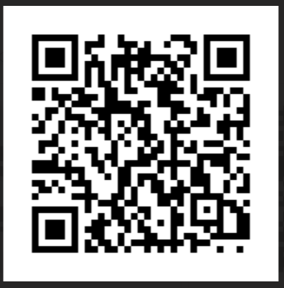
New Business
Vote to fill Councilor vacancy – Paul Easker
https://iastate.qualtrics.com/jfe/form/SV_1QYnerqLKQpYpfM

Slide 16
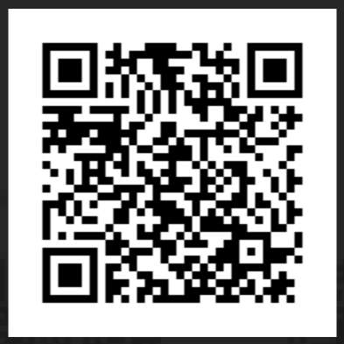
New Business
Vote to elect VP for Communications & Community Relations – Paul Easker
https://iastate.qualtrics.com/jfe/form/SV_esvTkNZd809ISwe

Slide 17
Open Discussion for the Betterment of Council
If you’d like to speak, please “Raise” your hand and wait to be acknowledged.
Once acknowledge, please unmute to share your discussion item(s)

Slide 18
Announcements
General Council Meeting
Thursday, Oct. 10, 2024
2:10 PM
4250 Student Innovation Center OR Teams
Executive Committee Meeting
Friday, Sept. 20, 2024
9-11 AM
1118 Student Innovation Center
Professional Development
Sept. Seminar Series: Exploring Research Excellence: What Carnegie R1 Means for You at Iowa State University
9.18.24 | 1160 Sweeney Hall | Register in Workday
2025 Conference
Thursday, Feb. 27, 2025
Gateway Hotel & Conference Center

